Slide 1


What About Foreclosures?
Notes:
https://www.gettyimages.com/detail/photo/the-housebubble-royalty-free-image/146963424?phrase=housing%2Bbubble

Slide 2
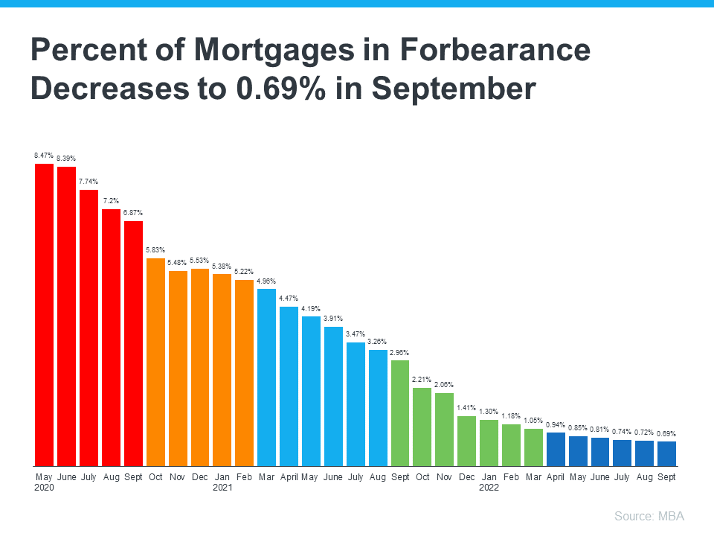

Slide 3
Only about 214,800 homeowners were facing possible foreclosure in the second quarter of 2022, or just four-tenths of one percent of the 58.2 million outstanding mortgages in the U.S.
Of those facing foreclosure, about 195,400, or 91 percent, had at least some equity built up in their homes.
- ATTOM Data
Notes:
https://www.attomdata.com/news/market-trends/home-sales-prices/attom-q2-2022-u-s-home-equity-and-underwater-report/

Slide 4
Housing Supply Is Still Historically Low
Inventory the Week Ending October 28th Compared to Last 3 Years
Source: Calculated Risk
Notes:
https://www.calculatedriskblog.com/2022/10/housing-october-31st-weekly-update.html

Slide 5


Should I Buy a Home
Right Now?
Notes:
https://www.gettyimages.com/detail/photo/indoor-life-portrait-of-a-young-asian-woman-royalty-free-image/1146227465?phrase=rental&adppopup=true

Slide 6
Median Asking Rent Since 1988
Source: Census
Notes:
http://www.census.gov/housing/hvs/files/currenthvspress.pdf
Table 11A. Median Asking Rent for the U.S. and Regions: 1988 to Present

Slide 7
If you can find a house that meets your financial expectations for a monthly payment and it is a good time for you to buy, then do that, . . . And if you wait for prices to fall but they never do, you may discover the hard way that the house that you found a year ago that you really loved, that you could afford but you passed up on, is more expensive next year.
- Odeta Kushi, Deputy Chief Economist, First American
Notes:
https://www.syracuse.com/business/2022/09/home-prices-might-drop-but-wont-crash-what-buyers-should-know.html

Slide 8
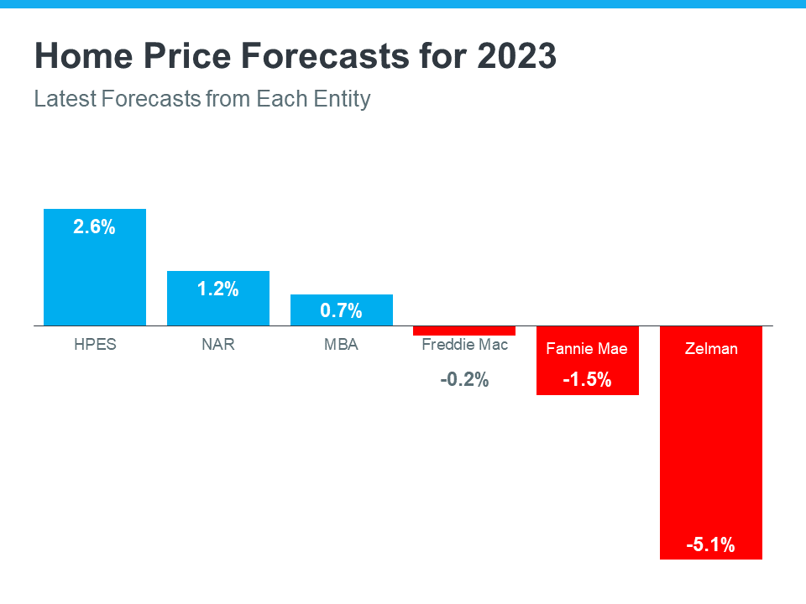

Slide 9
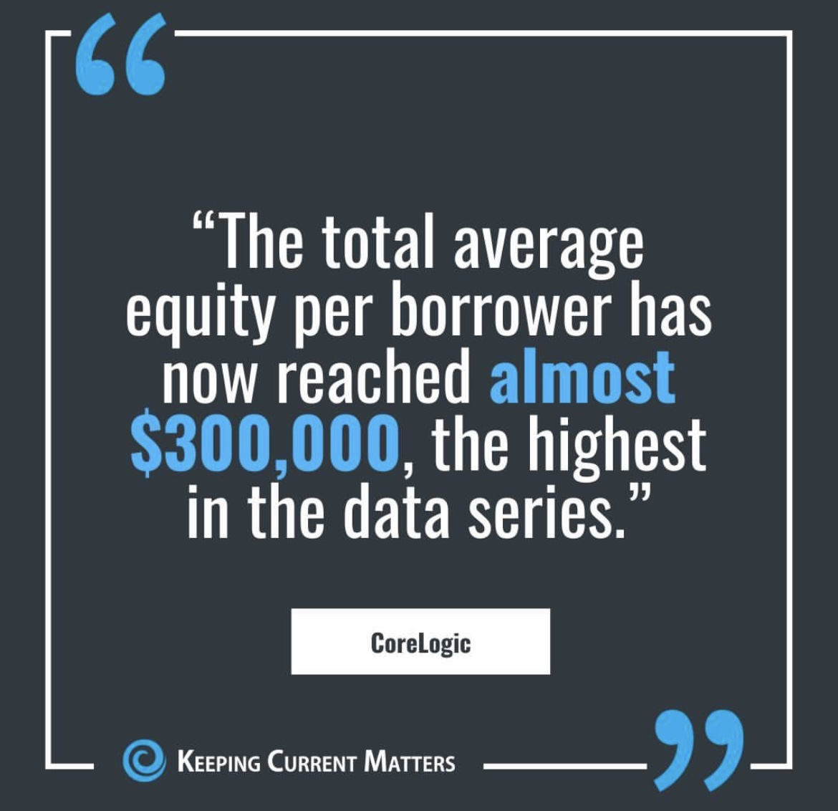

Slide 10
In the absence of trustworthy, up-to-date information, real estate decisions are increasingly being driven by fear, uncertainty, and doubt. These decisions can be hugely consequential for consumers and businesses.
- Jason Lewris, Co-Founder & Chief Data Officer, Parcl
Notes:
https://www.parcllabs.com/articles/q3-real-estate

