Slide 1


Slide 2
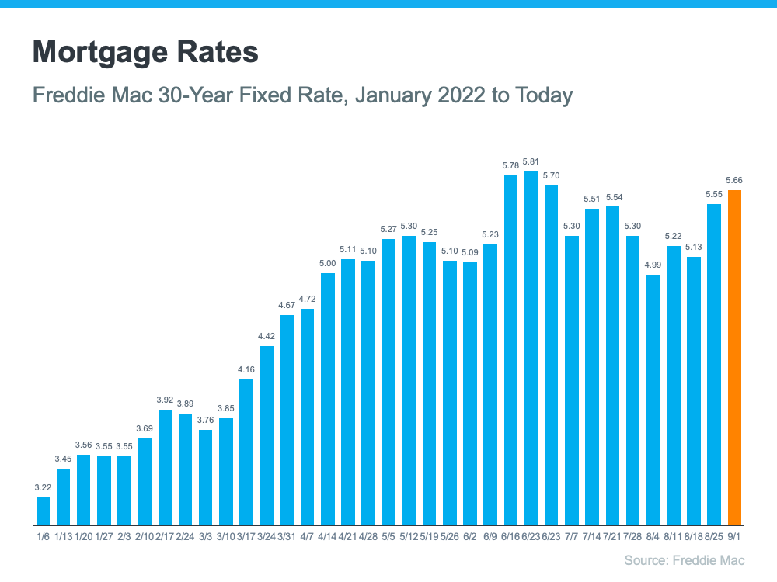

Slide 3
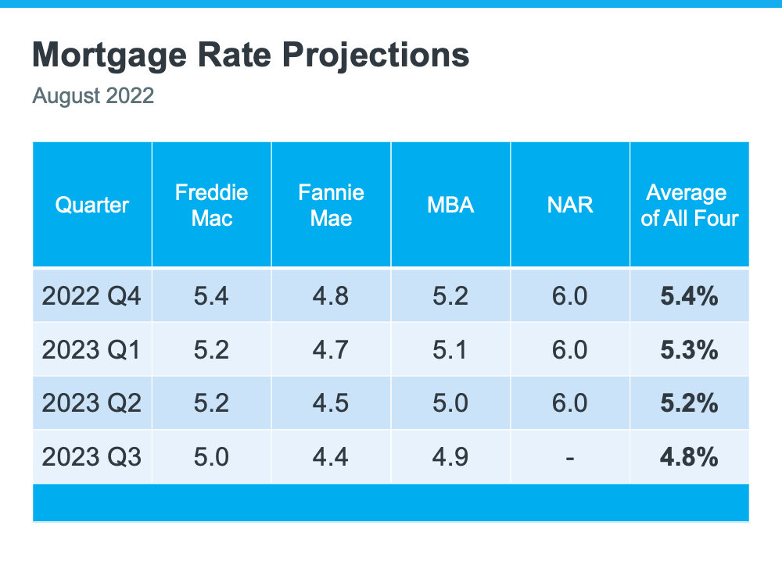

Slide 4
Active Inventory Increasing Dramatically
Active Monthly Listings in Thousands
Source: Realtor.com
Notes:
https://www.realtor.com/research/data/

Slide 5
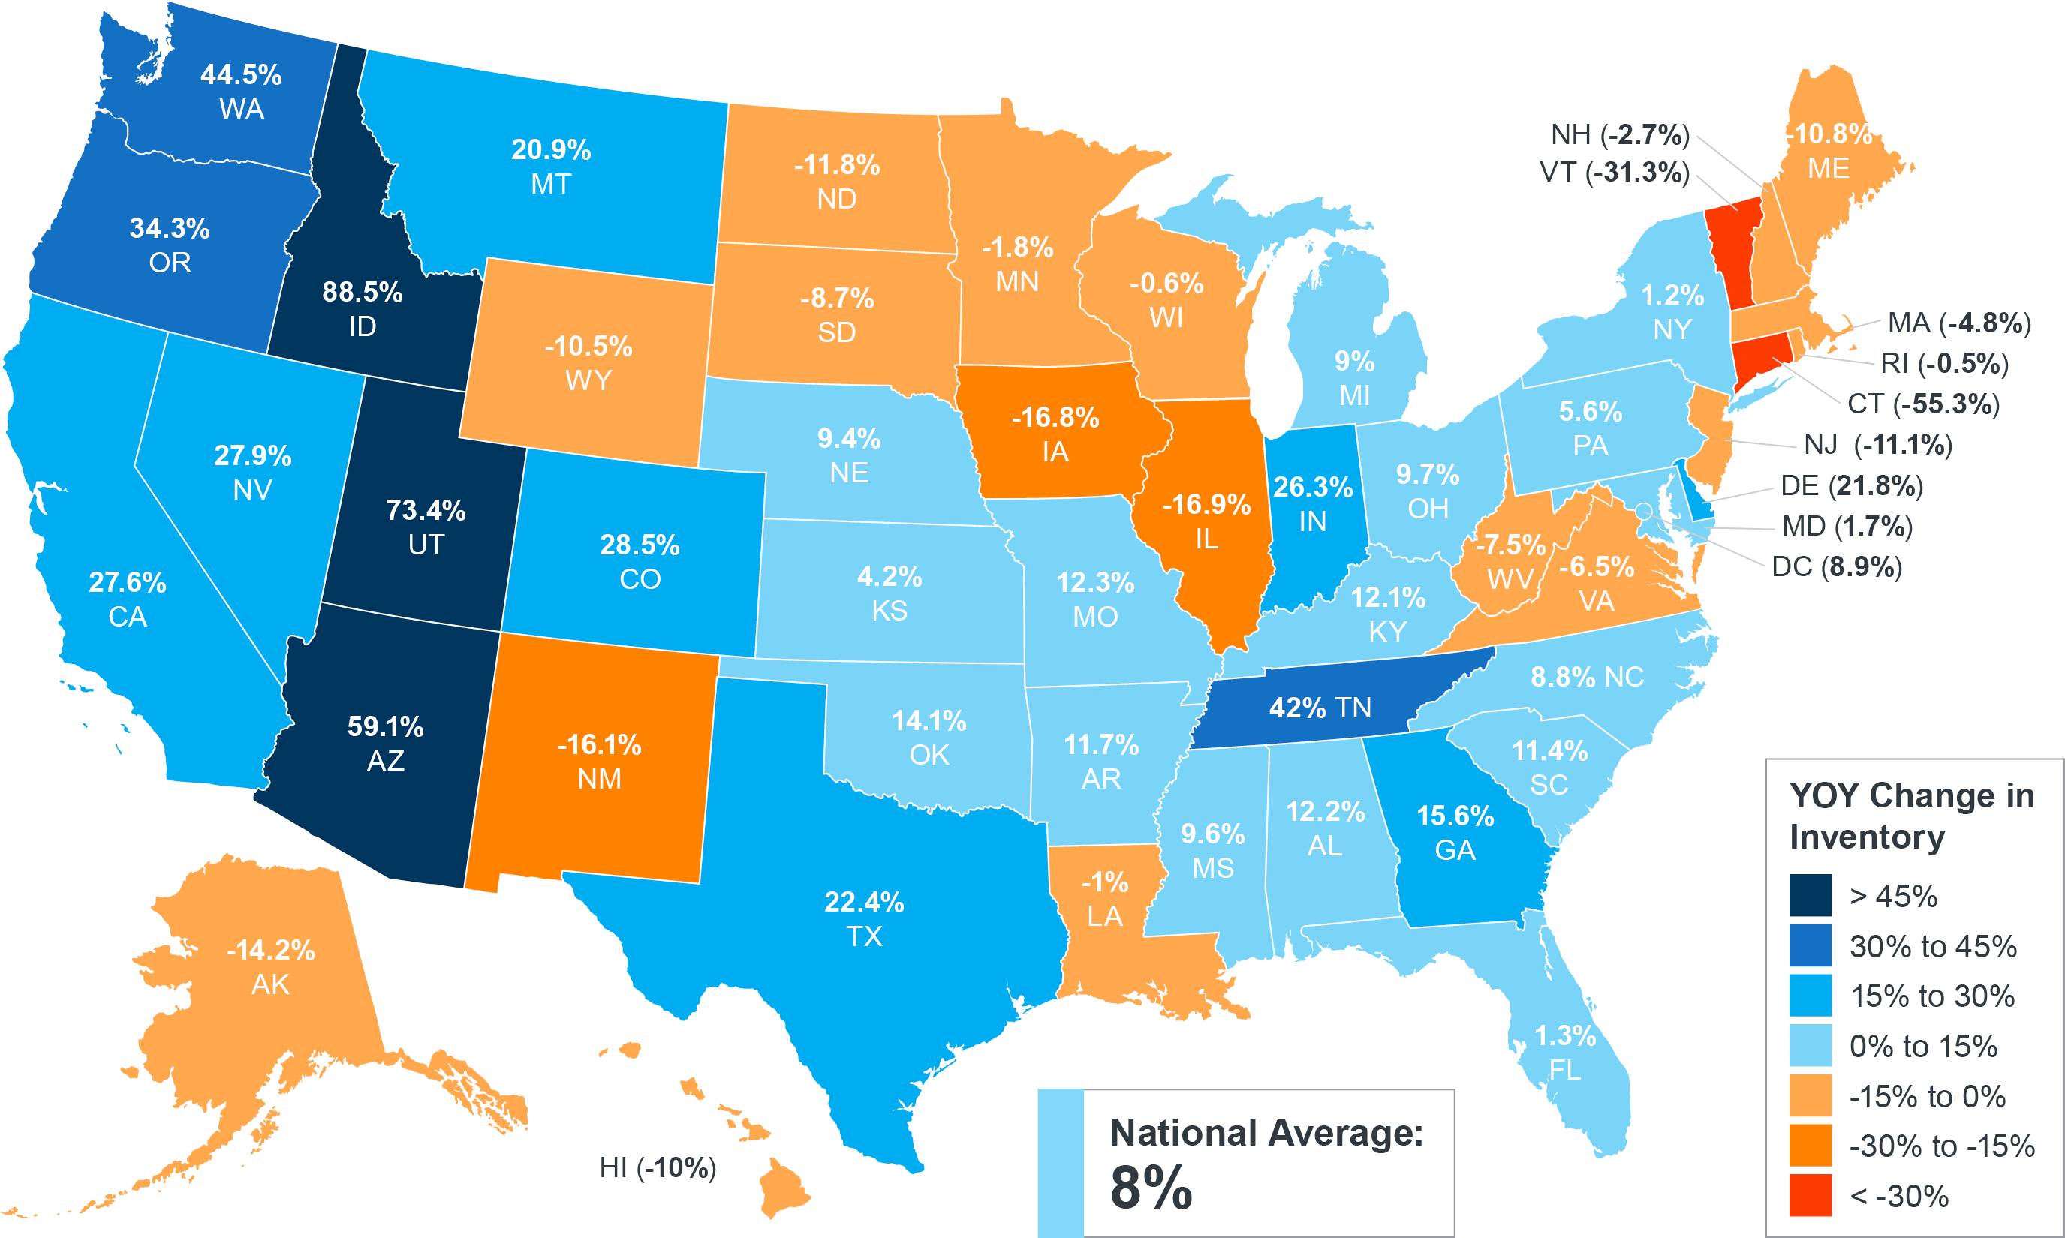
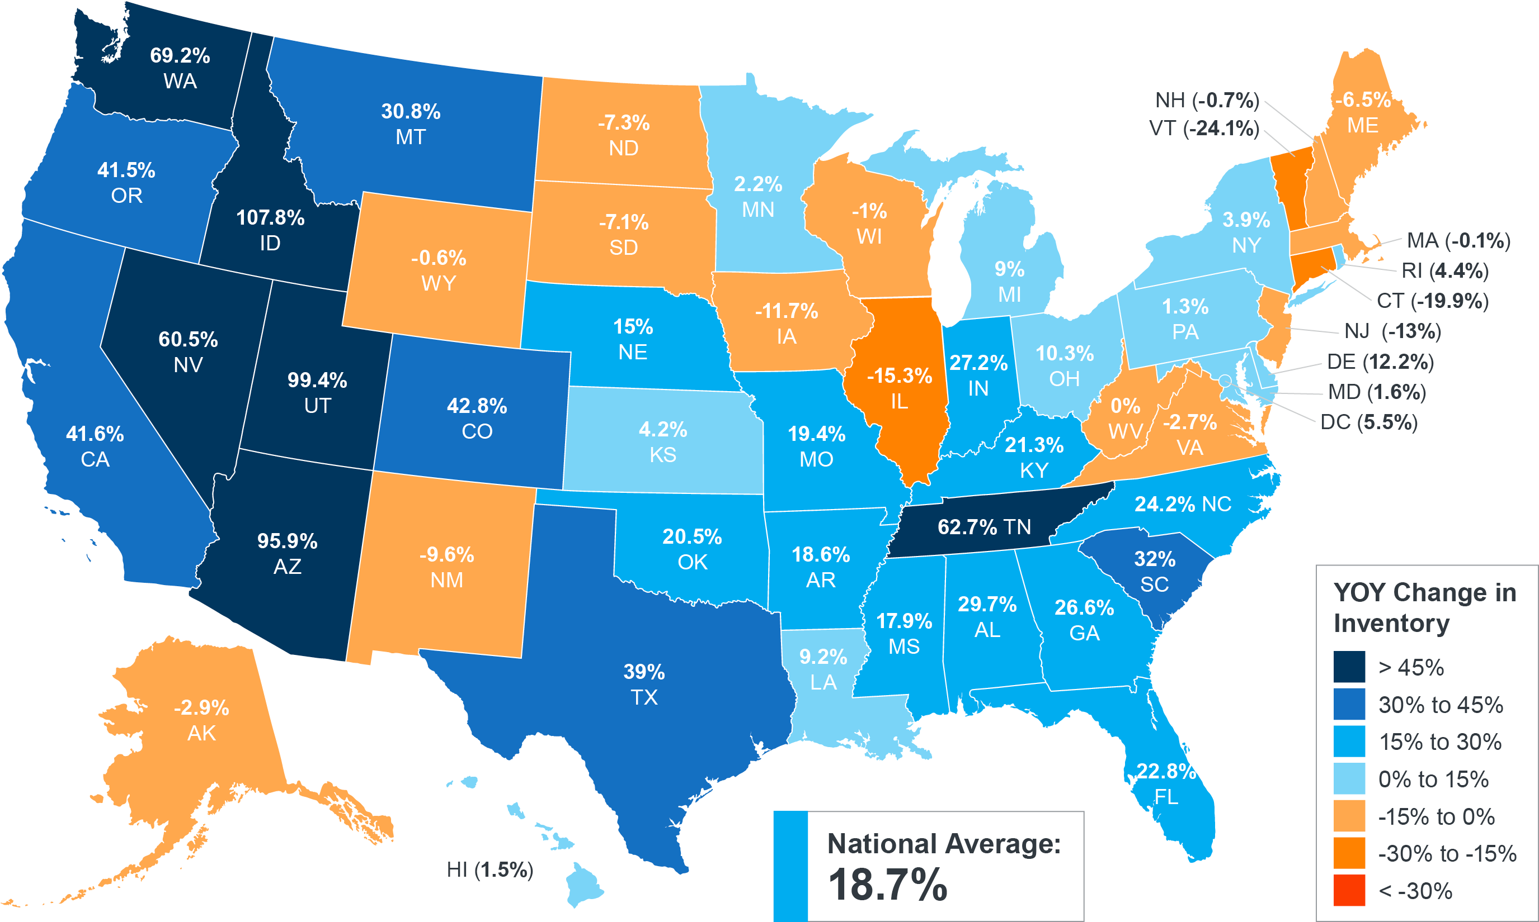
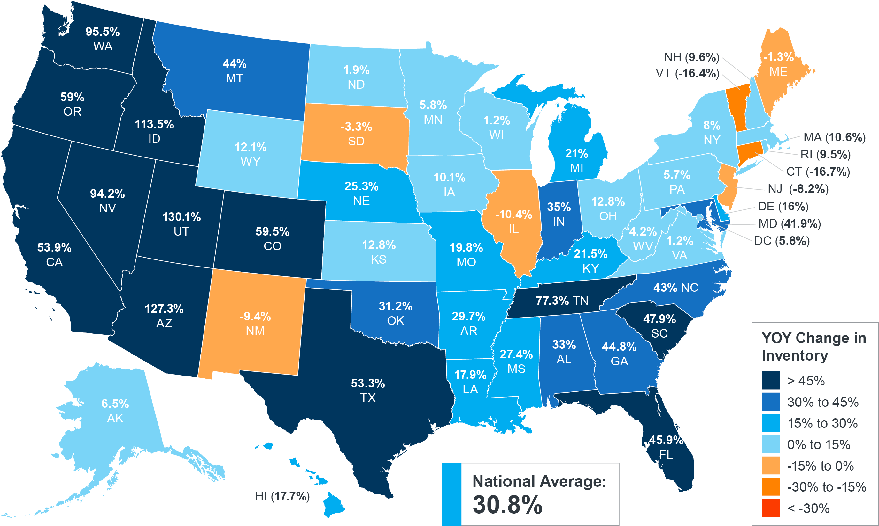
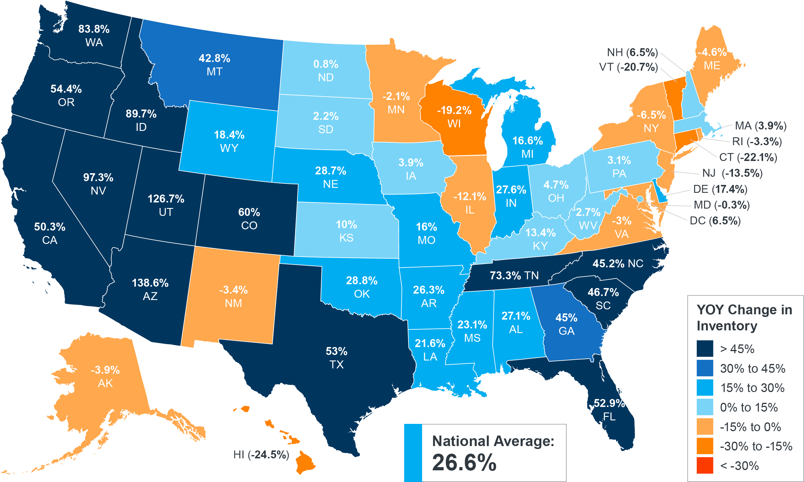
Year-Over-Year Change in Inventory
May
June
July
August
Source: realtor.com
Notes:
https://www.realtor.com/research/may-2022-data/
https://www.realtor.com/research/june-2022-data/
https://www.realtor.com/research/july-2022-data/
https://www.realtor.com/research/august-2022-data/
https://www.realtor.com/research/data/

Slide 6


Slide 7
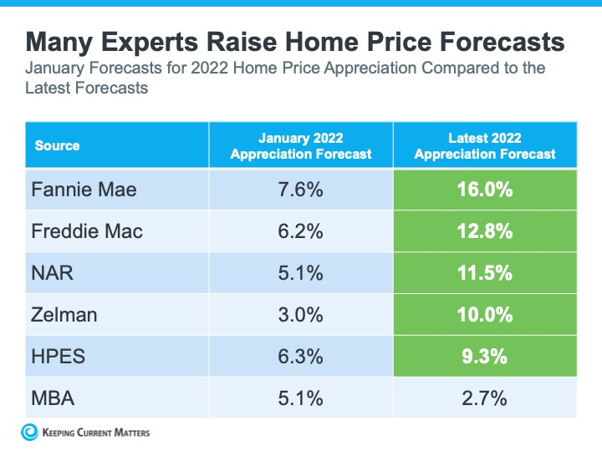

Slide 8
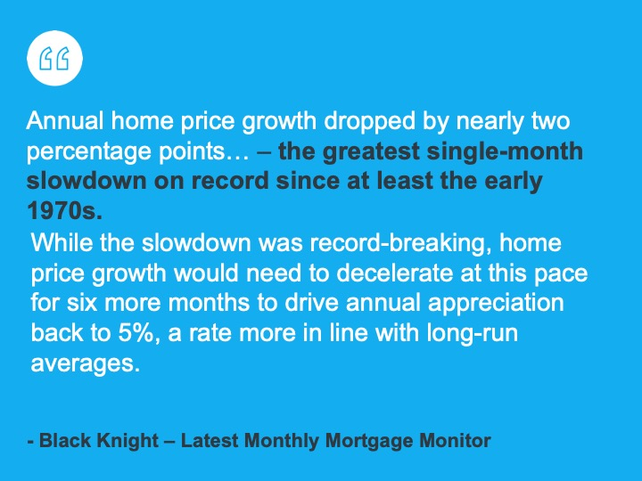

Slide 9
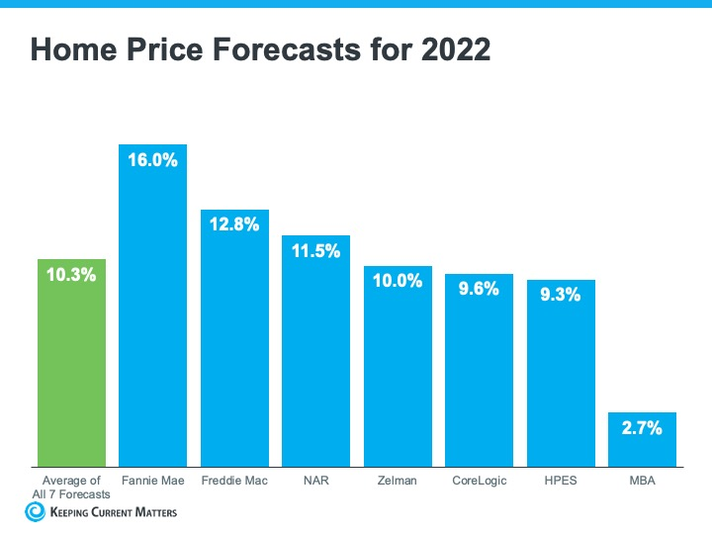

Slide 10


