Slide 1
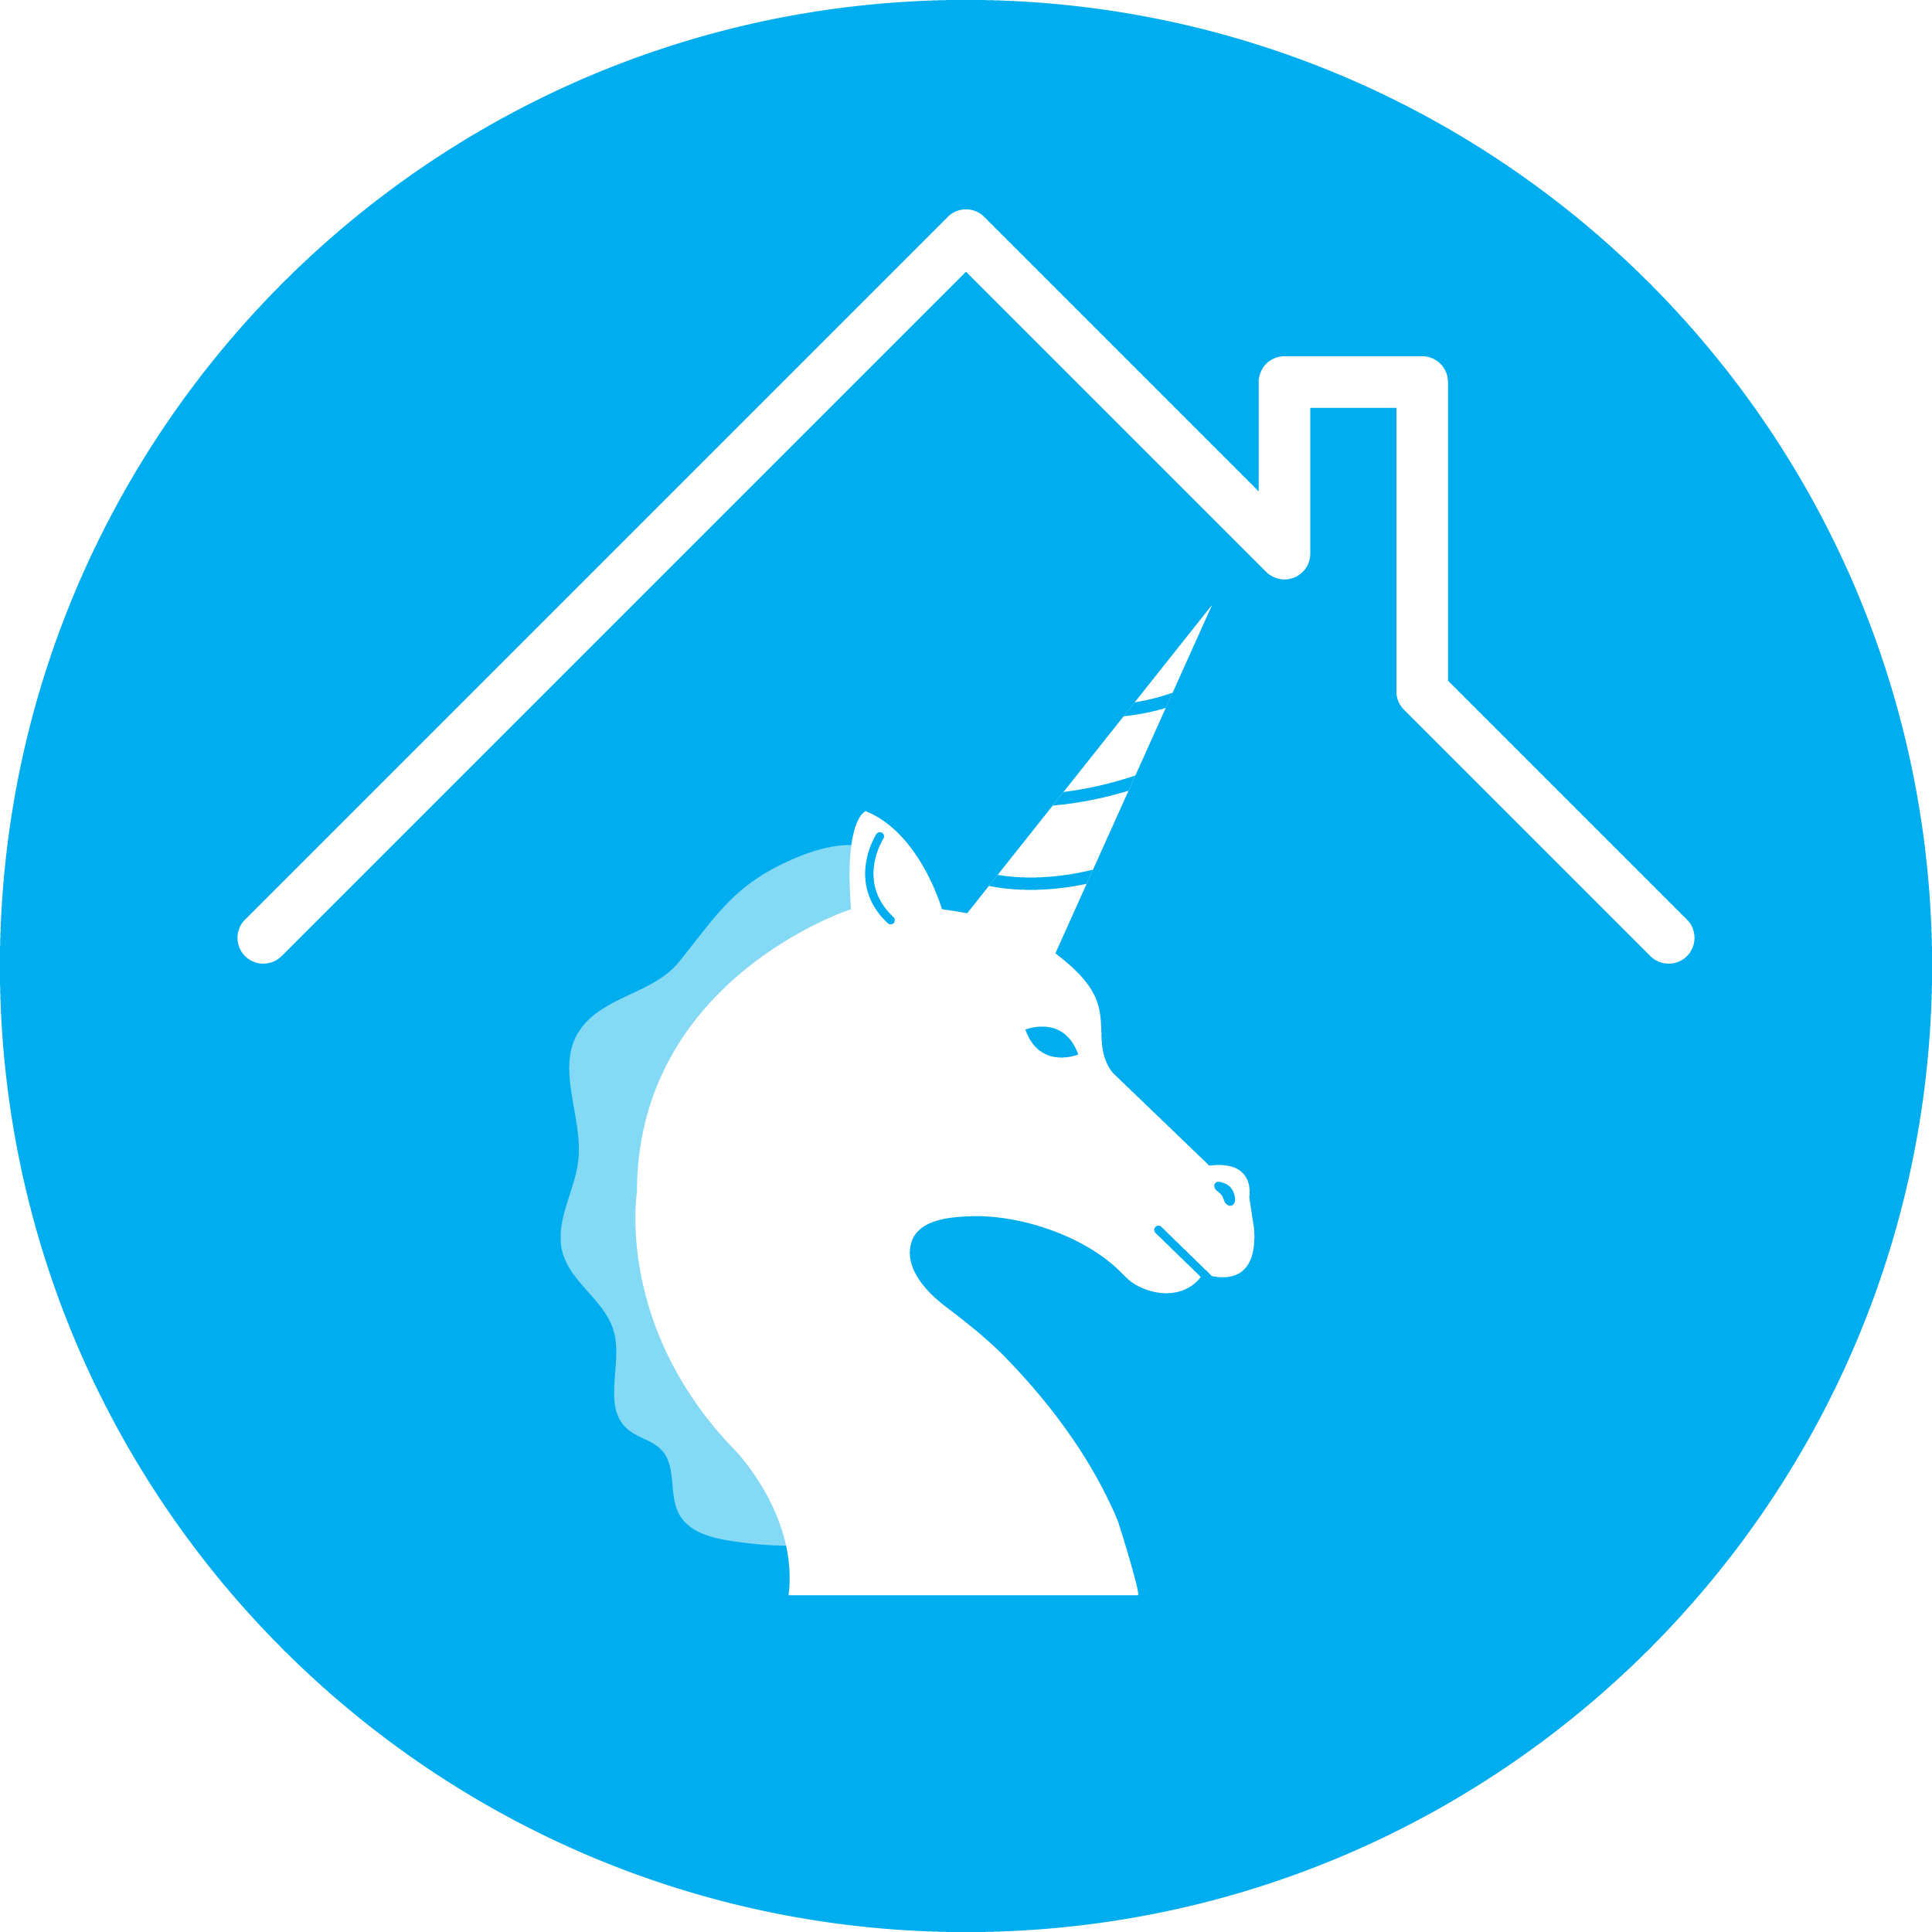
‘Unicorn Years’

Slide 2

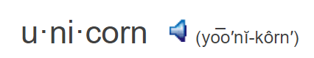
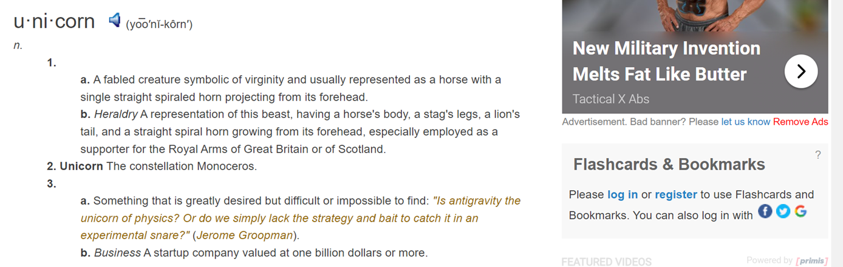
Notes:
https://www.thefreedictionary.com/unicorn

Slide 3

‘Unicorn’ Years
is our new term for the housing market during the ‘pandemic’ years.
It is our attempt to disconnect the benefits of the strong housing market of 2020Q2-2022Q2 from the pain so many experienced during that time.

Slide 4

Home Appreciation = Pre-Unicorn Years
Home Price Appreciation, Seasonally Adjusted, Rounded to Nearest Full #
‘Unicorn’ Years
Source: Freddie Mac
Notes:
https://www.freddiemac.com/research/indices/house-price-index

Slide 5
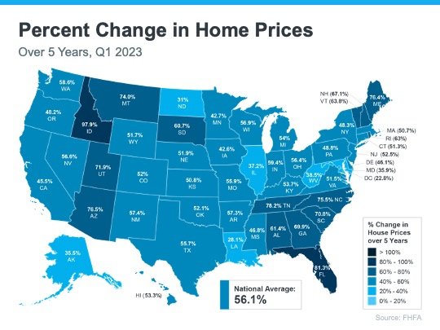

Slide 6
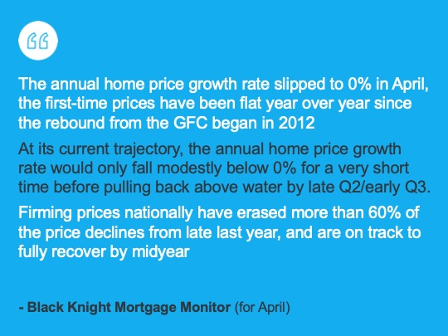

Slide 7


HEADLINES
DO MORE TO
TERRIFY
THAN
CLARIFY

Slide 8
Showing Traffic Above ‘Unicorn Years’
Showing Index for April over the Last 7 Years
‘Unicorn’ Years
Source: ShowingTime
Notes:
https://www.showingtime.com/showingtime-showing-index/

Slide 9
Fewer Foreclosures During ‘Unicorn’ Years
U.S. Properties with Foreclosure Filings
598,118 (Average: 2017– 2019)
‘Unicorn’ Years
Source: ATTOM
Notes:
https://www.attomdata.com/news/market-trends/foreclosures/attom-year-end-2022-u-s-foreclosure-market-report/

Slide 10
Inventory of Homes for Sale < Pre-Unicorn
May of Each Year
‘Unicorn’ Years
Source: Realtor.com
Notes:
https://www.realtor.com/research/data/

Slide 11
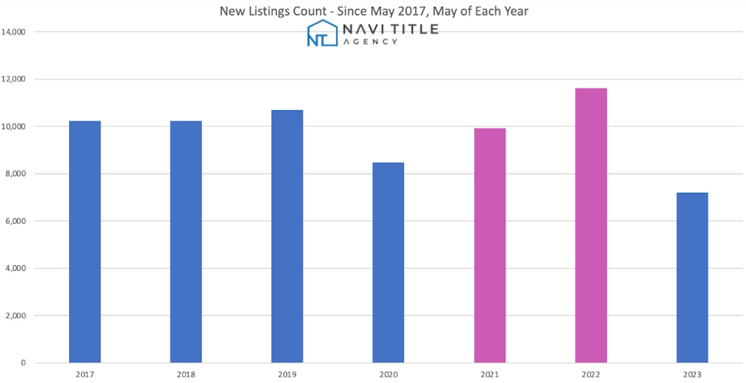

Slide 12
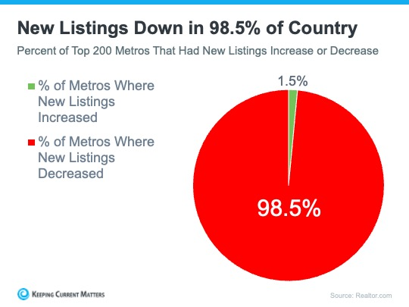

Slide 13
Pending Listings
May of Each Year
‘Unicorn’ Years
Source: Realtor.com
Notes:
https://www.realtor.com/research/data/

Slide 14
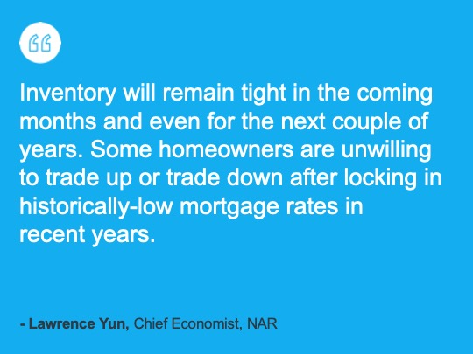

Slide 15
Existing Home Sales
May of Each Year
‘Unicorn’ Years
Source: NAR
Notes:
https://www.nar.realtor/research-and-statistics/housing-statistics/existing-home-sales

