Slide 1
The Year of
“Fives”
‘5’ Will Be the Handle (first number) on Mortgage Rates by May
5.5 Million in Total Home Sales
5% Will Be the Approximate Home Price Appreciation Rate

Slide 2
The Year of
“Fives”
‘5’ Will Be the Handle (first number) on Mortgage Rates by May
5.5 Million in Total Home Sales
5% Will Be the Approximate Home Price Appreciation Rate

Slide 3

Mortgage Rates

Slide 4
Mortgage Rates
30-Year Fixed Rate
- Actual - Projected
2023
2024
2019
2022
2018
2020
2021
Source: MBA
Notes:
https://www.mba.org/news-and-research/forecasts-and-commentary/mortgage-finance-forecast-archives
https://www.mba.org/docs/default-source/research-and-forecasts/forecasts/2023/mff_dec23.pdf

Slide 5
For over 50 Years, the 30-Year Mortgage Rate Has Moved in Unison with the 10-year Treasury Yield
Average Spread: 1.72
Current
Spread
2.78
Source: Freddie Mac, Macrotrends
Notes:
https://www.freddiemac.com/pmms/pmms_archives
https://www.macrotrends.net/2016/10-year-treasury-bond-rate-yield-chart

Slide 6
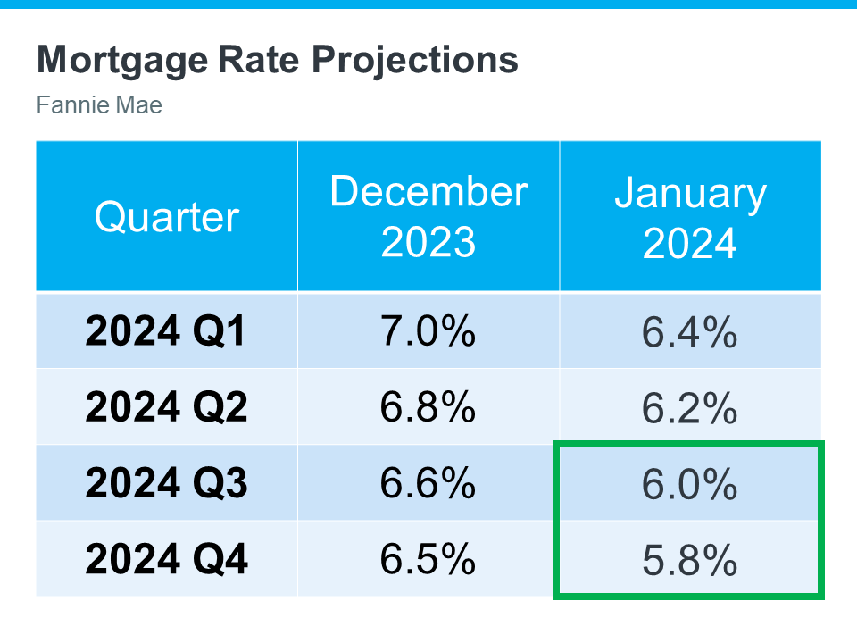

Slide 7
The Year of
“Fives”
‘5’ Will Be the Handle (first number) on Mortgage Rates by May
5.5 Million in Total Home Sales
5% Will Be the Approximate Home Price Appreciation Rate

Slide 8
Top 3 Reasons Buyers Paused Decision
Reasons Given for Pausing Their Purchase (Multiple Could Be Chosen)
Source: Bright MLS
Notes:
https://brightmls.com/article/market-survey-winds-of-change-expected-for-2024

Slide 9
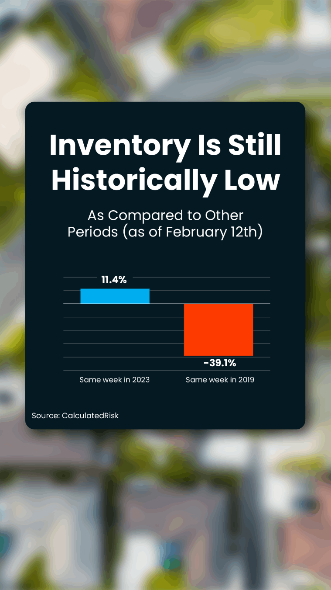

Slide 10
The market currently requires a higher level of new construction inventory due to a persistent lack of resale inventory. Newly built homes available for sale accounted for 31% of total homes available for sale in November, compared to an approximate 12% historical average.
- National Association of Home Builders
Notes:
https://www.nahb.org/news-and-economics/press-releases/2023/12/new-home-sales-down-in-november-but-should-improve-moving-forward

Slide 11
The Year of
“Fives”
‘5’ Will Be the Handle (first number) on Mortgage Rates by May
5.5 Million in Total Home Sales
5% Will Be the Approximate Home Price Appreciation Rate

Slide 12

Home Prices

Slide 13
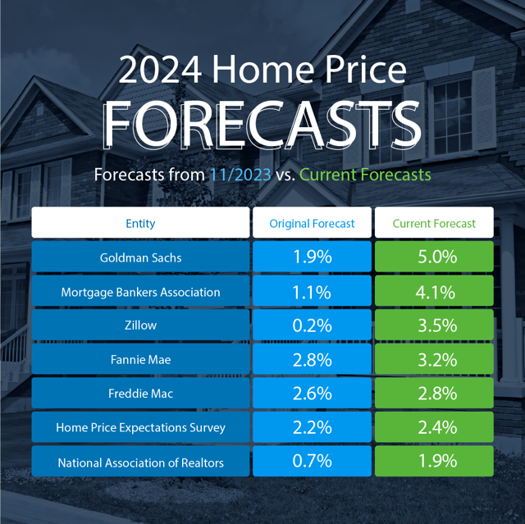

Slide 14
Estimated Home Price Performance
December to December, as Forecast in Q4 2023
Recovery
To Date
Pre-Bubble
Bubble
Bust
Source: HPES
Notes:
https://pulsenomics.com/surveys/#home-price-expectations

Slide 15
Potential growth in household wealth over the next
5 years based solely on increased home equity if you purchase a $400K home in January 2024
$72,405
Recovery
To Date
Pre-Bubble
Bubble
Bust
Based on price appreciation projected by the Home Price Expectation Survey
Source: HPES
Notes:
https://pulsenomics.com/surveys/#home-price-expectations

Slide 16
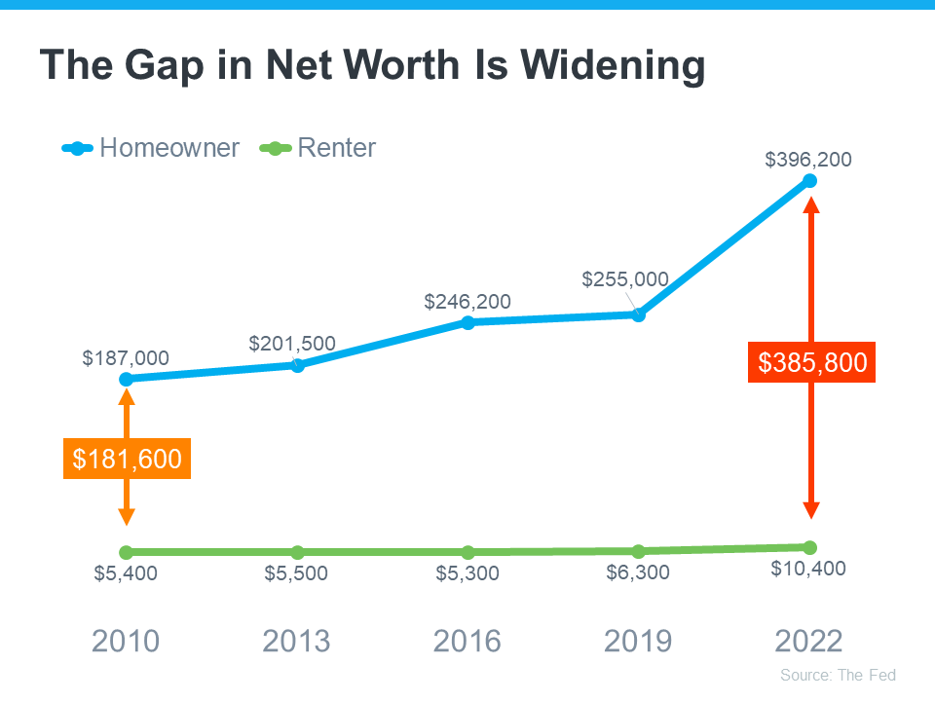

Slide 17
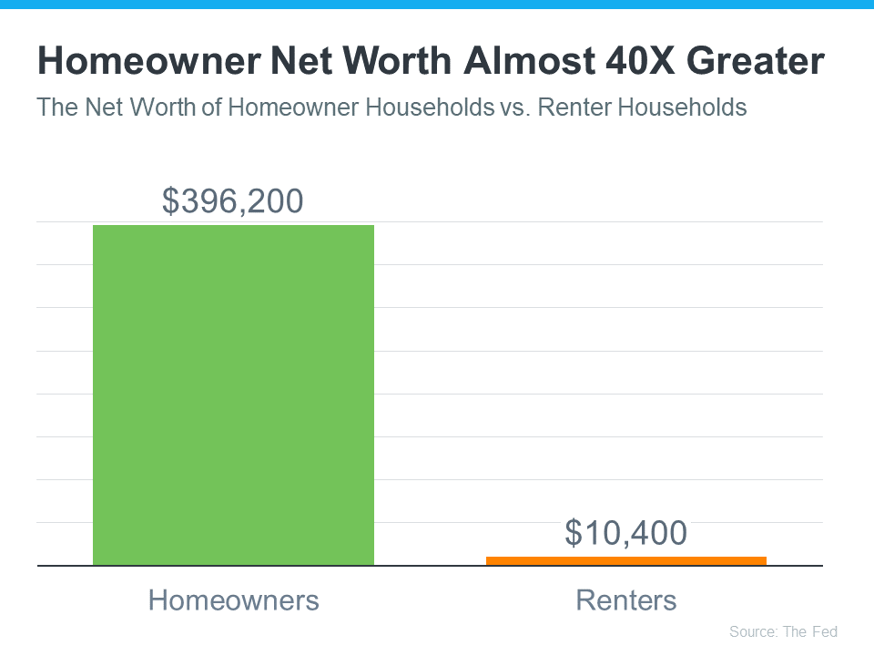

Slide 18
