Slide 1

Inventory Challenges
Part 1: What We Need to Know

Slide 2
Single-Family Housing Units Completed
Average Annual Units Completed
14 Straight Years Below
52-Year Average
Source: Census
Notes:
www.census.gov/construction/nrc/xls/co_cust.xls
Average: 1,009 2022: 1,022

Slide 3
Housing Market Short Millions of Homes
Number of Homes Each Company Forecasts the Market Being Short
Company | # of Homes Short
realtor.com | -5.24 Million
Bank of America | -4 Million
Freddie Mac | -3.8 Million
Morgan Stanley | -2 Million
John Burns Consulting | -1.7 Million
Moody’s Analytics | -1.6 Million
Source: Lance Lambert, Forbes
Notes:
https://twitter.com/NewsLambert/status/1559643944421556225

Slide 4
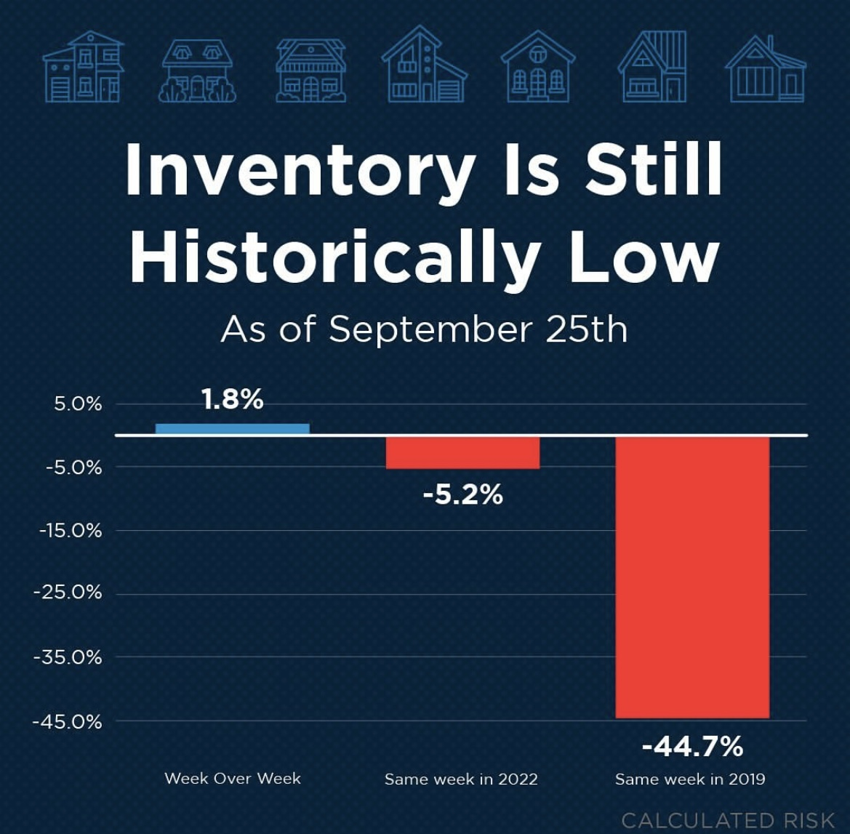

Slide 5
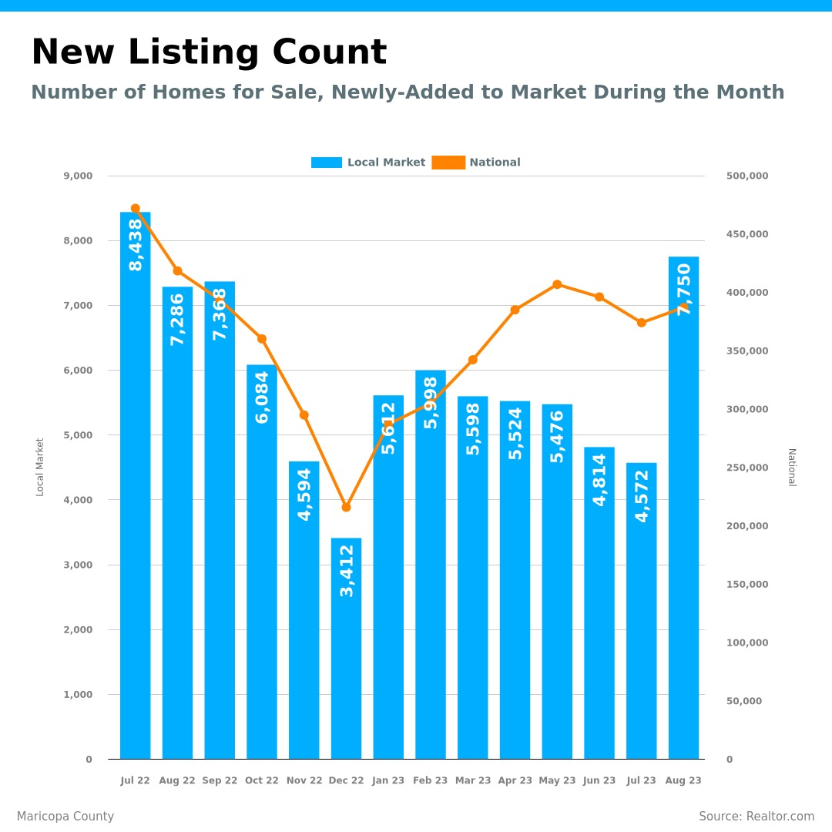

Slide 6
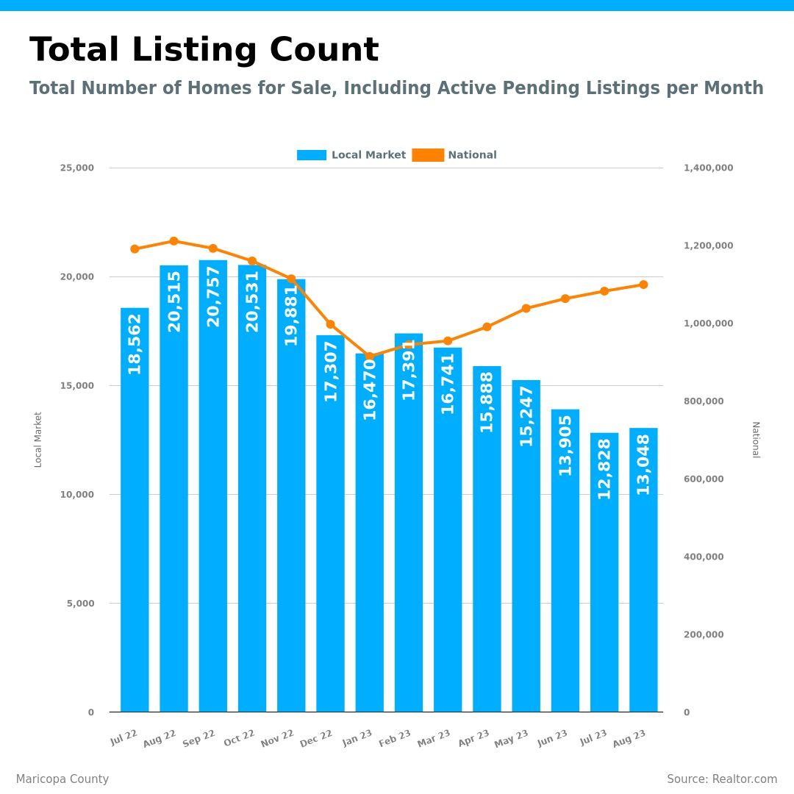

Slide 7

Mortgage Rates

Slide 8
You know, the fallacy of economic forecasting is don't ever try and forecast interest rates and or, more specifically, if you're a real estate economist mortgage rates, because you will always invariably be wrong.
- Mark Fleming, Chief Economist, First American
Notes:
https://blog.firstam.com/economics/reconomy-podcast-2021-housing-market-outlook

Slide 9
70.7% of Mortgage Rates Less Than 4%
Current FHFA Loans with Mortgage Rate at Time of Origination
Source: FHFA
Notes:
https://www.fhfa.gov/DataTools/Downloads/Pages/National-Mortgage-Database-Aggregate-Data.aspx

Slide 10
“Lock-In Rates” Limit New Inventory
Current FHFA Loans with Mortgage Rate at Time of Origination
Probably
Yes
Not Selling
Must Think Hard
Before Selling
Probably Not Selling
Source: FHFA
Notes:
https://www.fhfa.gov/DataTools/Downloads/Pages/National-Mortgage-Database-Aggregate-Data.aspx

Slide 11
Inflation and 30-Year Fixed-Rate Mortgage
Mortgage Rates Tend To Track Government Bonds and Inflation with a Lag
Sources: BLS, Freddie Mac
Notes:
https://www.bls.gov/cpi/
https://www.freddiemac.com/pmms

Slide 12
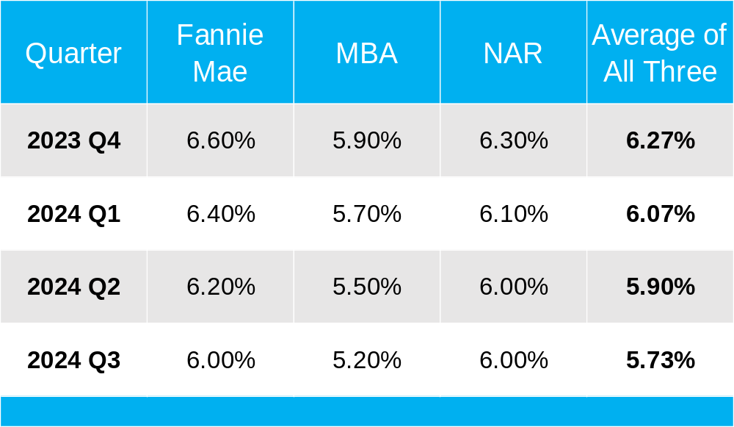
Mortgage Rate Projections
August 2023
Notes:
https://www.fanniemae.com/media/48386/display
https://www.mba.org/docs/default-source/research-and-forecasts/forecasts/mortgage-finance-forecast-jul-2023.pdf
https://cdn.nar.realtor/sites/default/files/documents/forecast-q3-2023-us-economic-outlook-07-27-2023.pdf

Slide 13
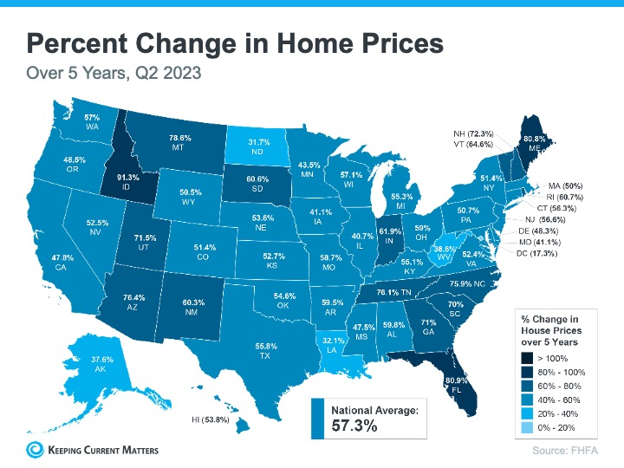

Slide 14
Americans Sitting on Tremendous Equity
68.7% Have Paid off Their Mortgage or Have at Least 50% Equity
Source: Census, ATTOM
Notes:
https://data.census.gov/cedsci/all?q=mortgage
https://www.attomdata.com/news/market-trends/home-sales-prices/attom-q2-2023-u-s-home-equity-and-underwater-report/

Slide 15
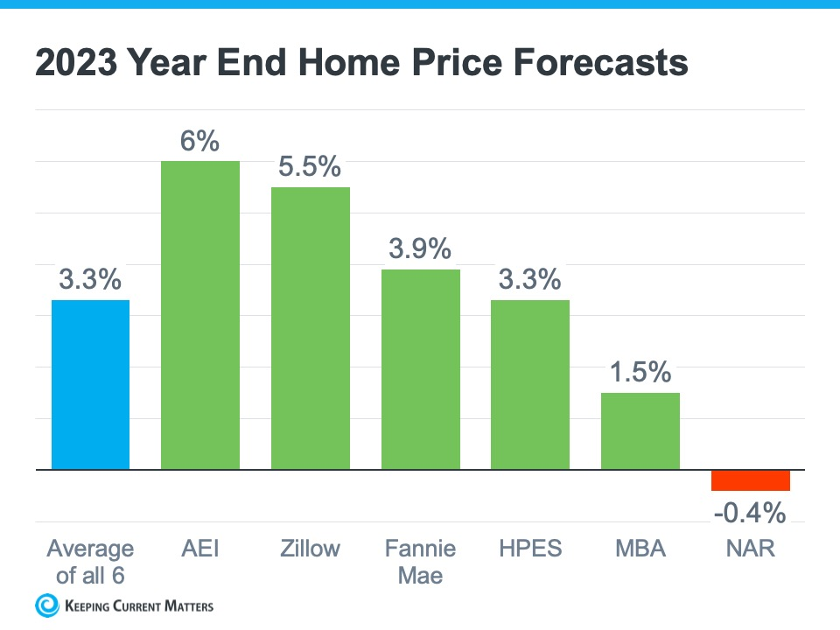

Slide 16
