Slide 1



2024 Forecast
“Supply and Demand”

Slide 2
Market Odds on Fed Cut
Upcoming Fed meetings | Fed Funds Futures cut odds
January 31 | 7%
March 20 | 68%
May 1 | 94%
June 12 | 100%
July 31 | 100%
September 18 | 100%
November 7 | 100%
December 18 | 100%
56% chance of 50bp
91% chance of 50bp, 53% 75bp

Slide 3
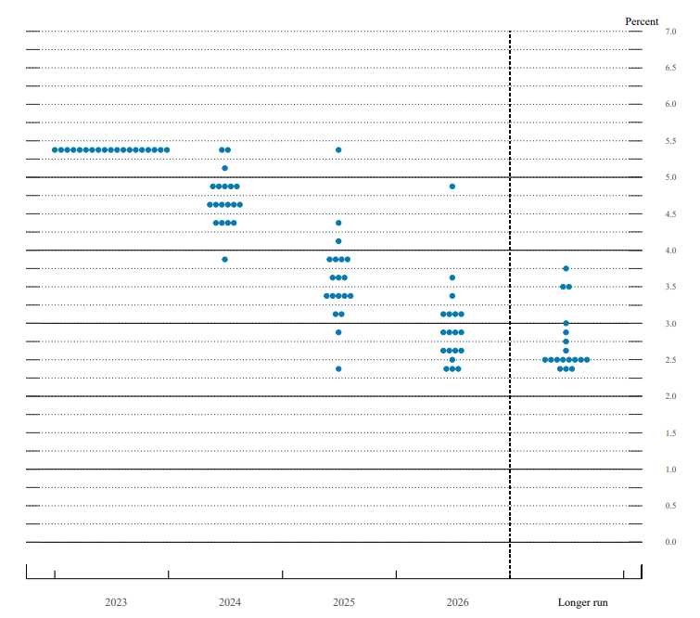
Fed Dot Plot 19 dots, each dot represents one member
Zero cuts
25bp cut
50bp
75bp
100bp
150bp
Notes:
Fed fund rate is between 5.25 and 5.5

Slide 4
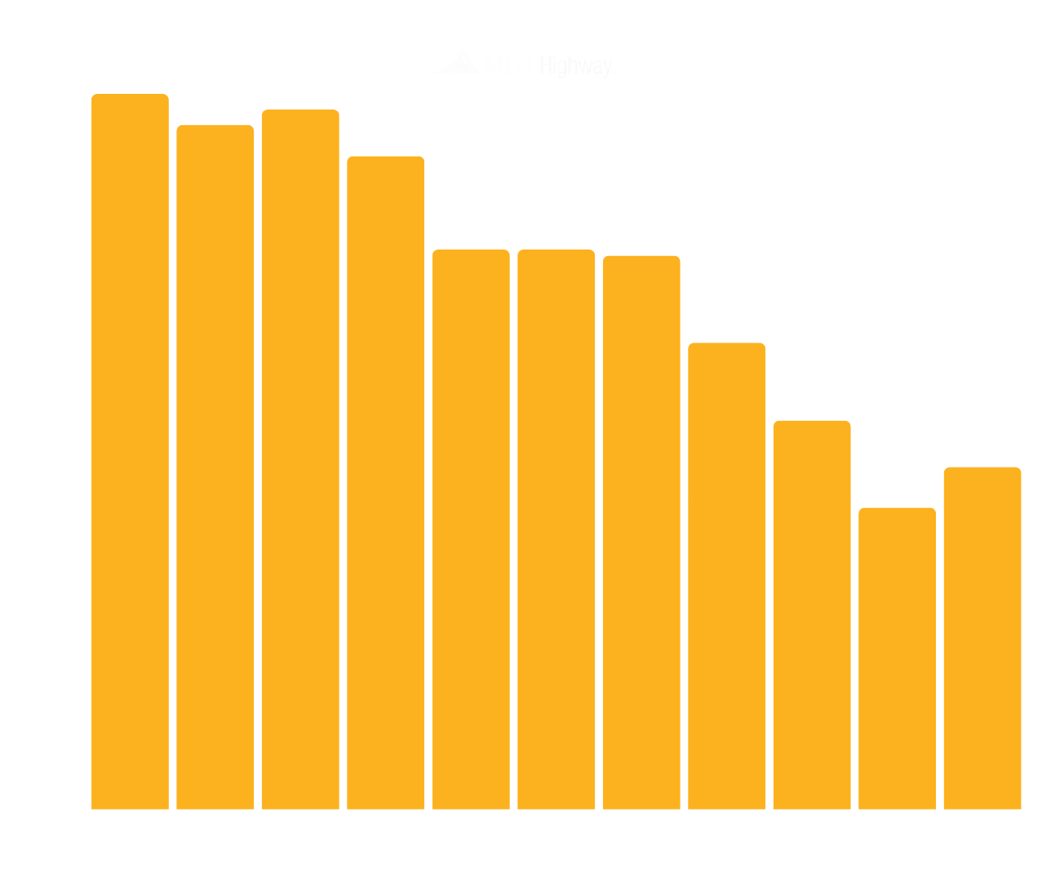
2024 Real Estate Forecast
Inventory remains tight
In Millions

Slide 5
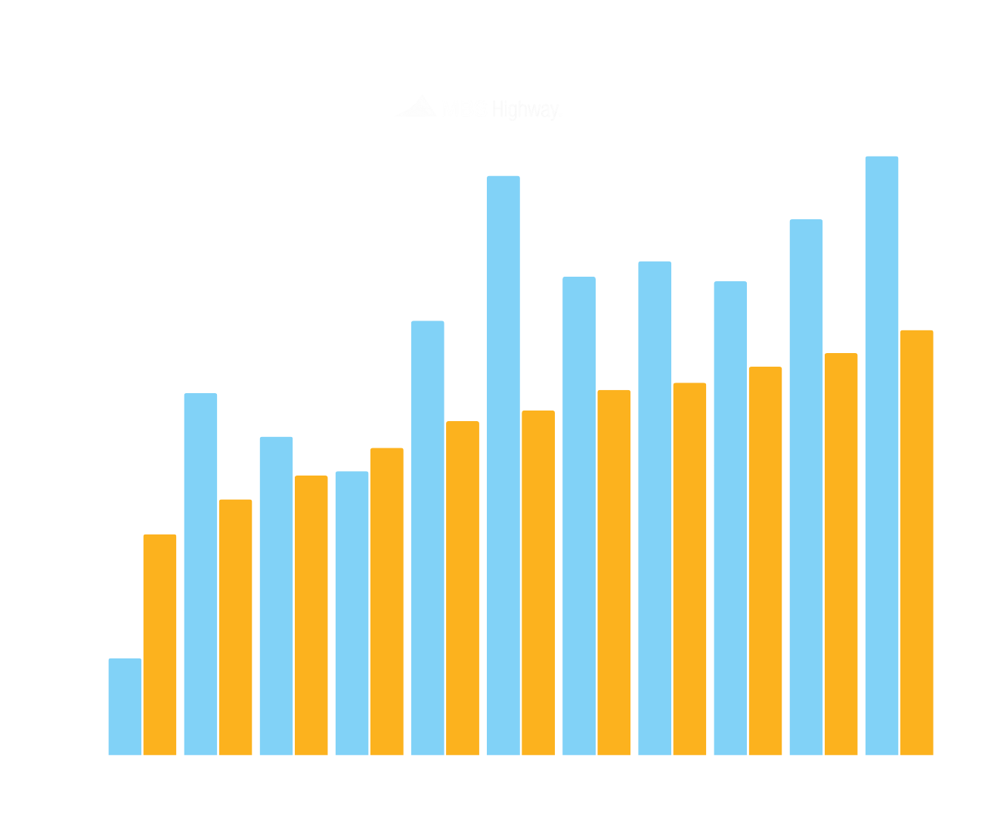
2024 Real Estate Forecast
Household formations outpace completions
In Millions
Formations
Completions

Slide 6
2024 Real Estate Forecast
Nationwide Appreciation
4.5% to 5%
Transaction Volume up 15 – 20%

