Slide 1
Price Appreciation over the Last 60 Years
Average Sales Price of Houses Sold in the United States
Source: The Fed
Notes:
https://fred.stlouisfed.org/series/ASPUS
2023-10-01 492,300

Slide 2
Increase in Rents over the Last 60 Years
Median Monthly Rent in the United States (1960–2023)
Source: iProperty
Notes:
https://ipropertymanagement.com/research/average-rent-by-year

Slide 3
48 Consecutive Quarters of Positive
Price Appreciation
Year-Over-Year, Seasonally-Adjusted (Purchase Only)
Source: FHFA
Notes:
https://www.fhfa.gov/AboutUs/Reports/Pages/US-House-Price-Index-Report-2023Q4.aspx
https://www.fhfa.gov/DataTools/Downloads/Pages/House-Price-Index-Datasets.aspx#qpo

Slide 4
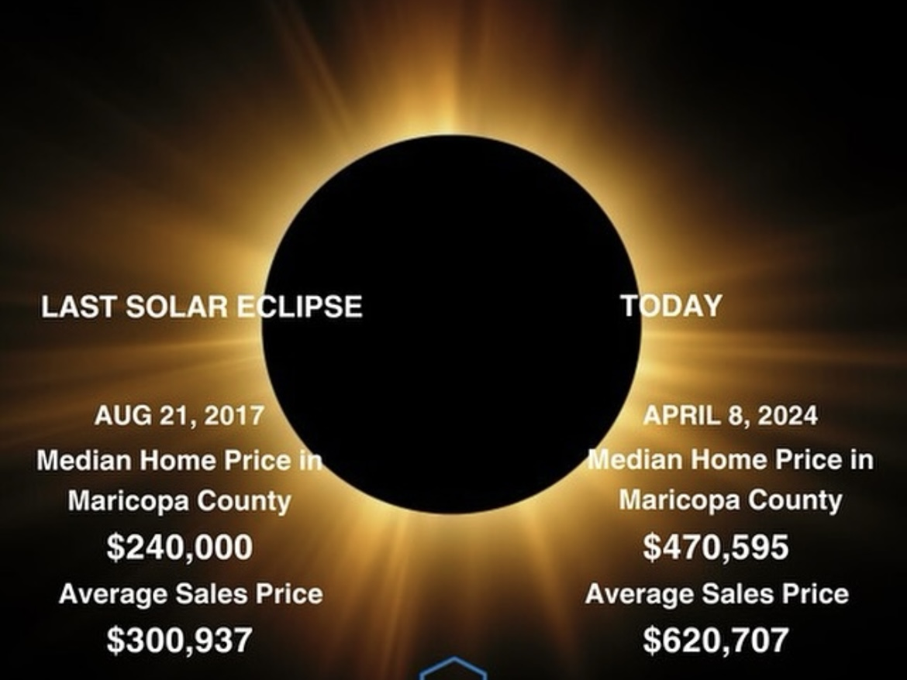

Slide 5
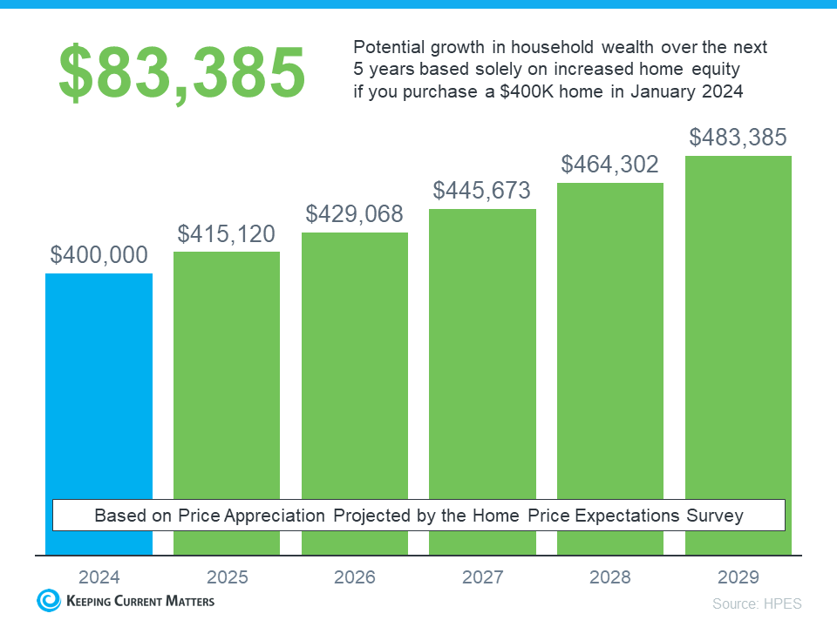

Slide 6


Slide 7
Americans Sitting on Tremendous Equity
67.4% Have Paid off Their Mortgage or Have at Least 50% Equity
Mortgage Homes
w/ > 50% Equity
Own the Home
Free and Clear
Mortgage Homes
w/ < 50% Equity
Source: Census, ATTOM
Notes:
https://data.census.gov/cedsci/all?q=mortgage
https://www.attomdata.com/news/market-trends/home-sales-prices/attoms-q4-2023-home-equity-and-underwater-report/ https://www.fhfa.gov/Media/Blog/Pages/Homeowners-Equity-Remains-High.aspx

Slide 8
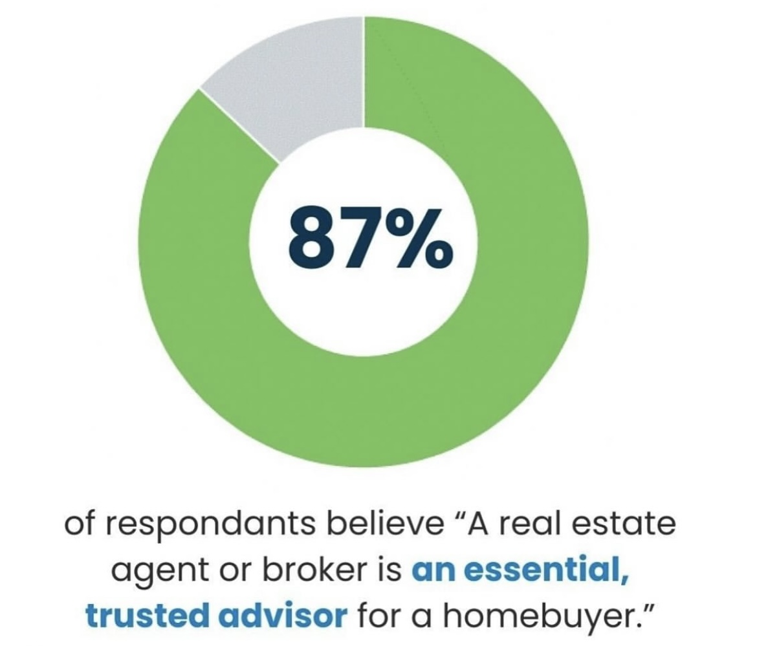

Slide 9
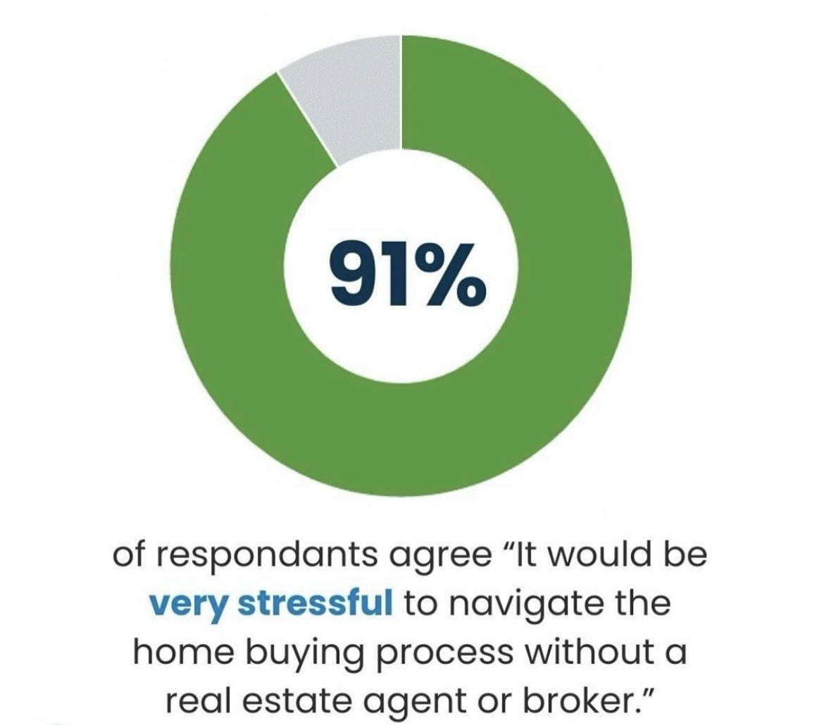

Slide 10
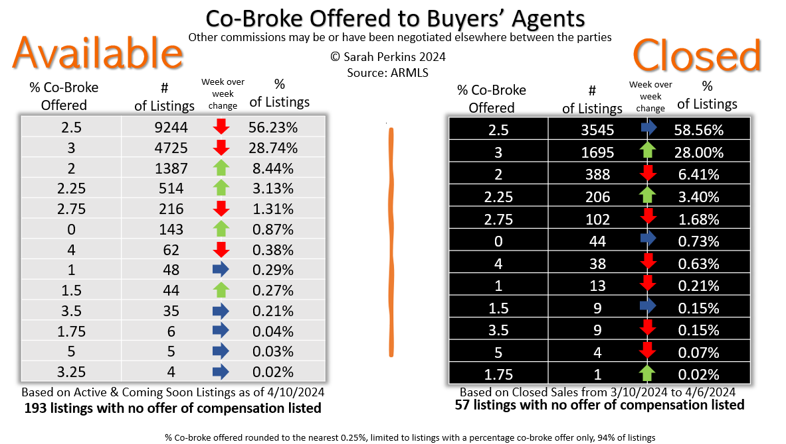

Slide 11


